Slide 1
Image Filtering Using the Fourier Transform
Presented by : Prateek Rajput

Slide 2

Background:
Digital Images are a part of our daily life
Importance of digital image processing increasing everyday
Increasing resolution of images or reducing noise remain hot topics
Fourier Transformation to transform gray pixel values into frequencies
Further processes on the transformed frequency matrix

Slide 3
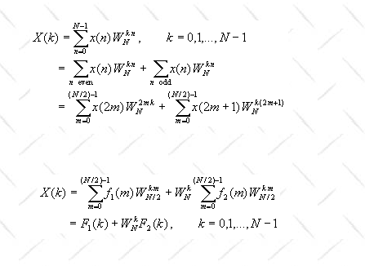
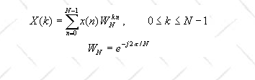
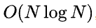
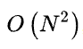
DFT and FFT:
Digital images are discrete because pixels are not continuous. That means we should implement Discrete Fourier Transformation (DFT) instead of Fourier Transformation. However, DFT process is often too slow to be practical. That is the reason why I chose Fast Fourier Transformation (FFT) to do the digital image processing
FFT
DFT

Slide 4
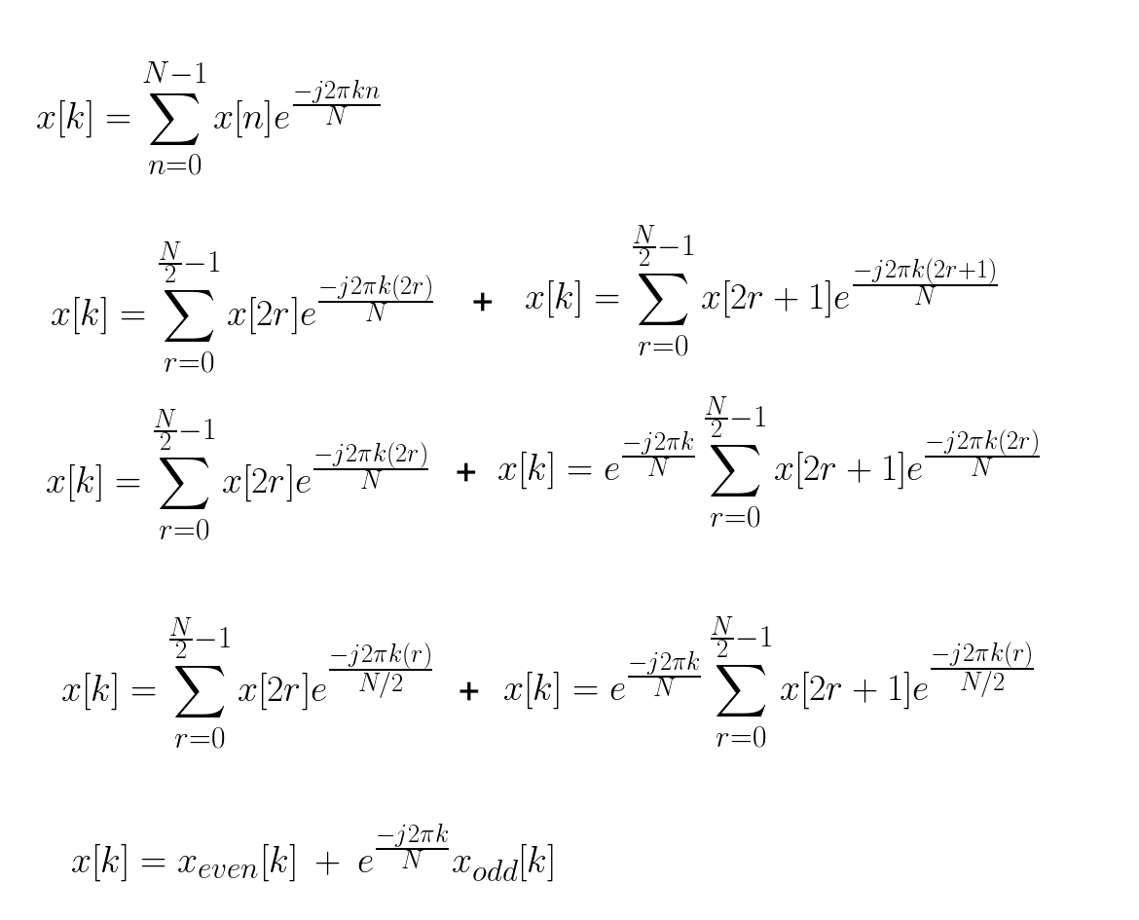
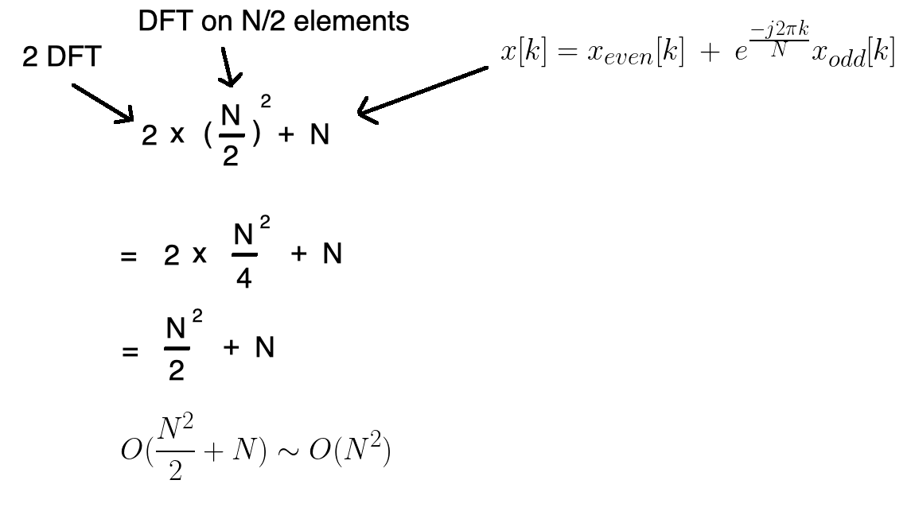
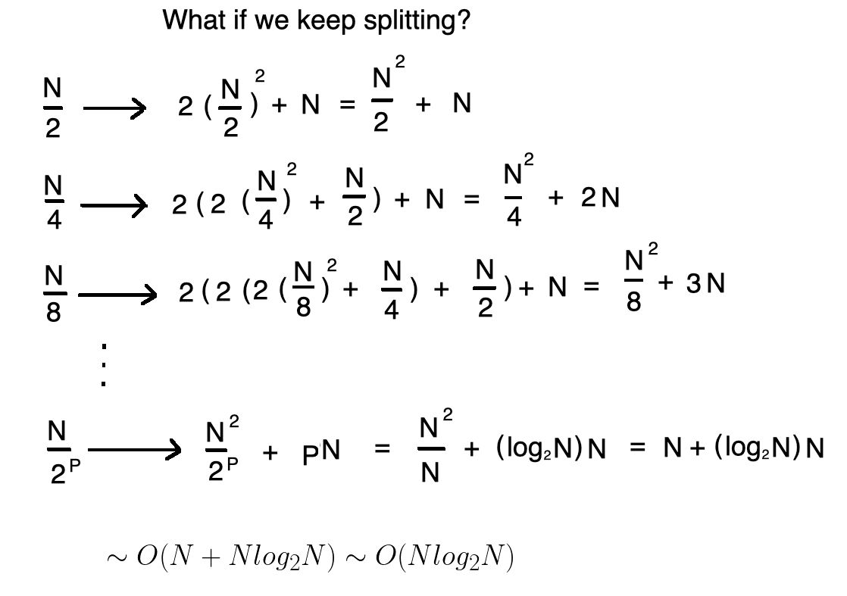
Time Complexity of FFT:
Source: https://towardsdatascience.com/fast-fourier-transform-937926e591cb

Slide 5
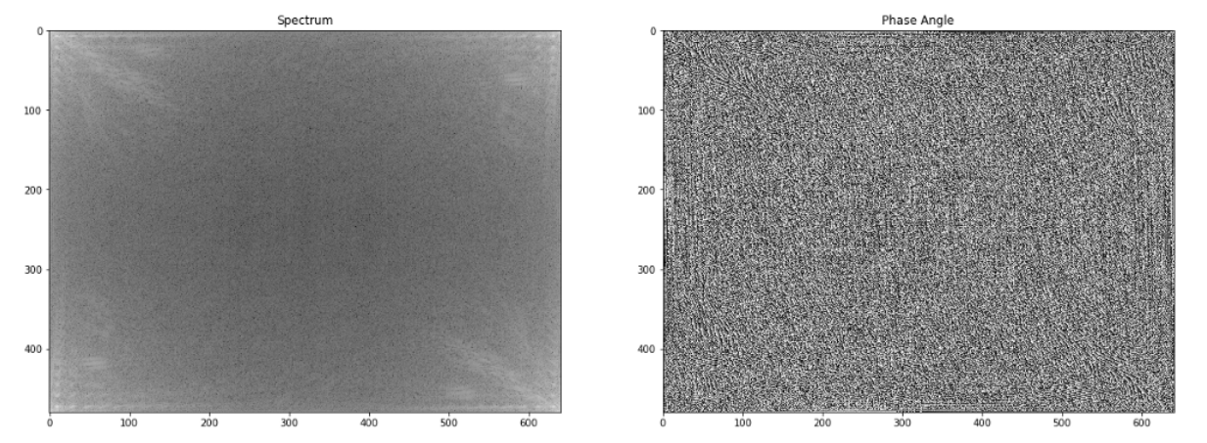
Visualizing the complex FT :
The phase preserves the shape characteristics which is an indispensable information for an image
The white area on the corner indicates that there is high energy in low/zero frequencies

Slide 6
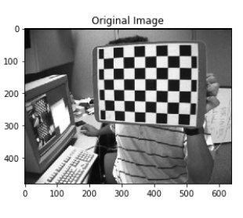
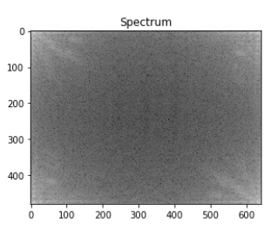
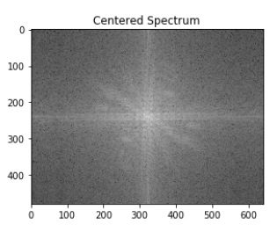
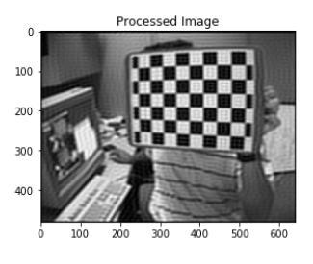
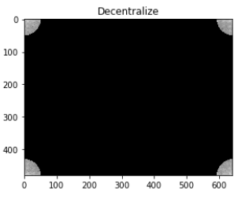
FFT process flow:

Slide 7
Filters:
Ideal
Butterworth
Gaussian
Low Pass
High Pass

Slide 8
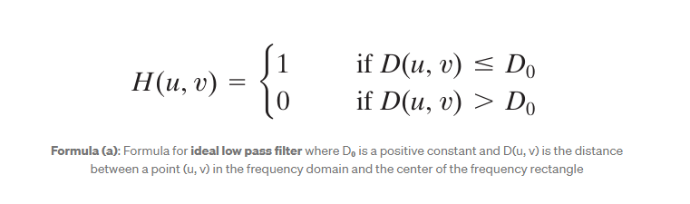
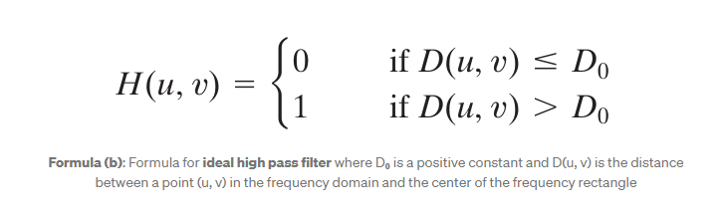
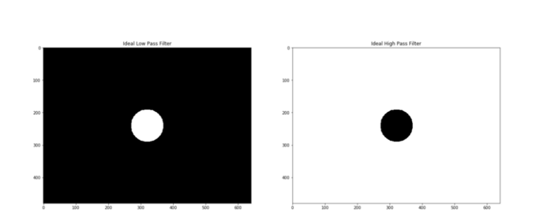
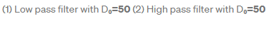
Ideal Filter:

Slide 9
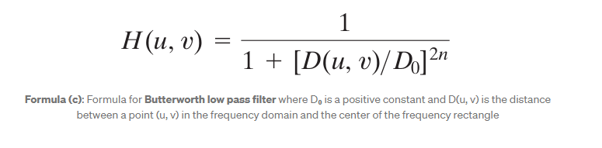
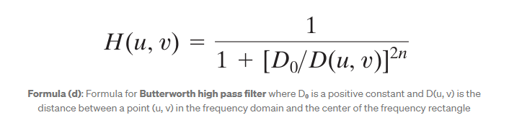
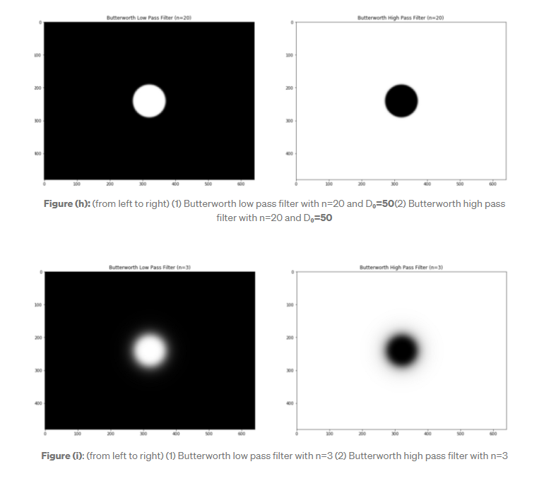
Butterworth Filter:
Comparison with varying D_{o} in results
n is a marker for the clearness of cutoff

Slide 10
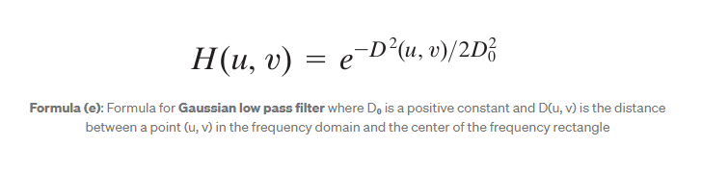
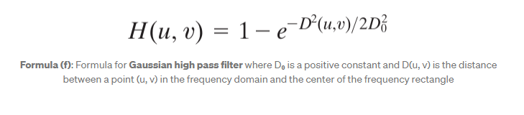
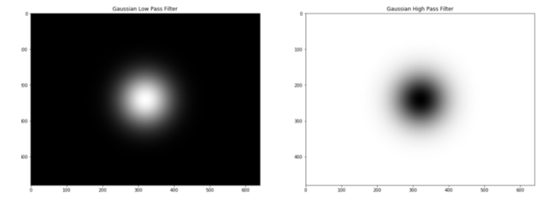
Gaussian Filter:
Comparison with varying D_{o} in results

Slide 11
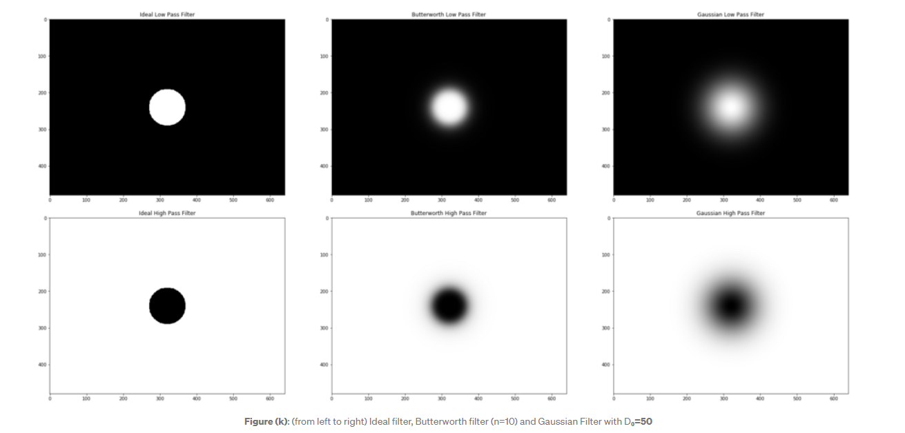
Filter Comparison:

Slide 12
Methodology of comparison wrt noise:
import random
def sp_noise(image,prob):
'''
Add salt and pepper noise to image
prob: Probability of the noise
'''
output = np.zeros(image.shape,np.uint8)
thres = 1 - prob
for i in range(image.shape[0]):
for j in range(image.shape[1]):
rdn = random.random()
if rdn < prob:
output[i][j] = 0
elif rdn > thres:
output[i][j] = 255
else:
output[i][j] = image[i][j]
return output
image = cv2.imread('100.jpg',0) # Only for grayscale image
for k in range(9):
noise_img = sp_noise(image,0.05*(k+1))
cv2.imwrite('sp_noise'+str(k+1)+'.jpg', noise_img)
Image
Generated images with different noise levels
Low pass filter
High pass filter
Comparison with the original image using different metrics

Slide 13
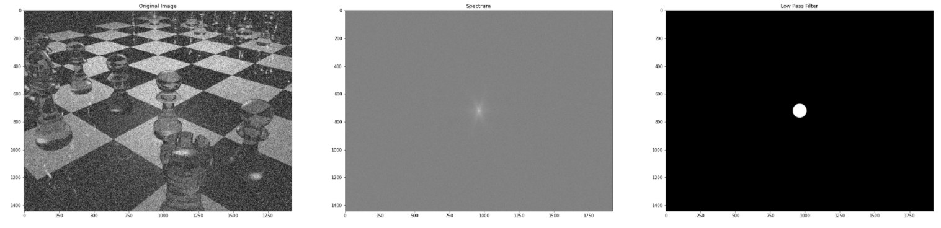
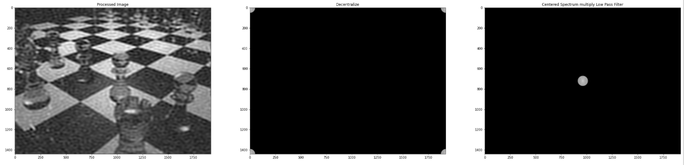
Low Pass Filter:

Slide 14
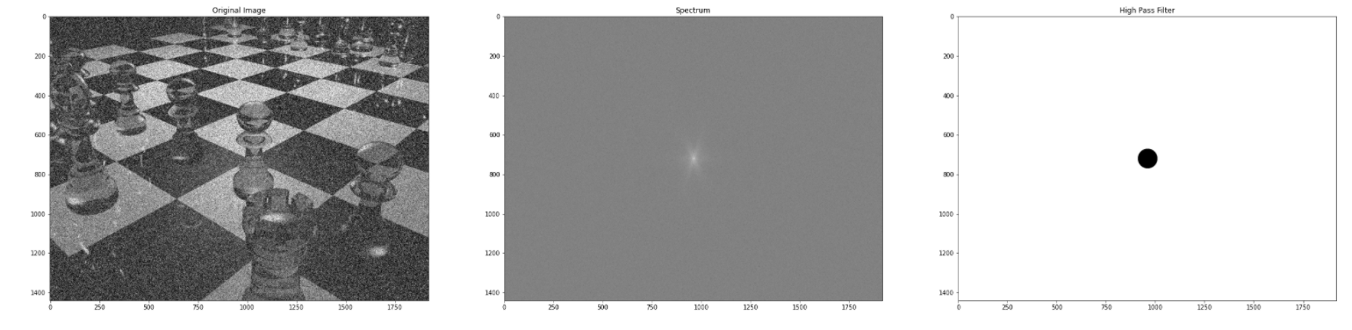
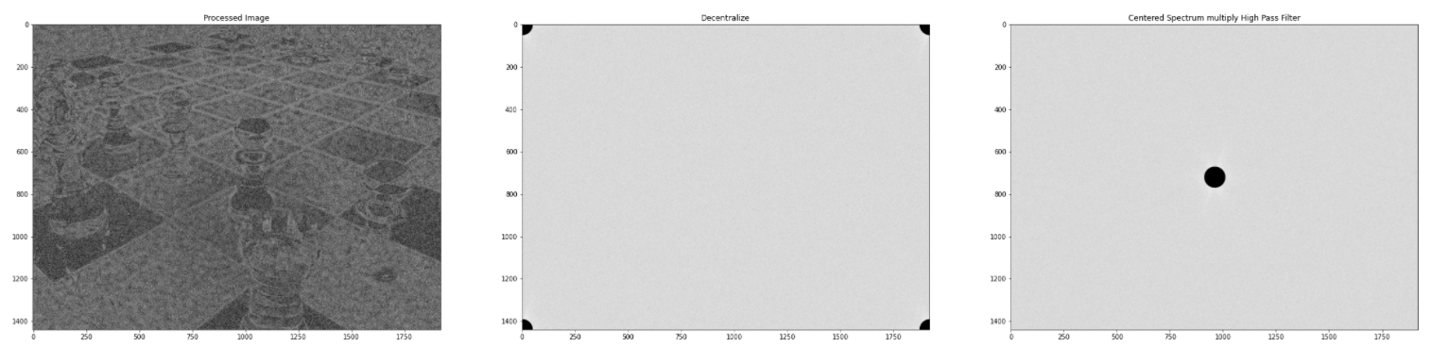
High Pass Filter:

Slide 15
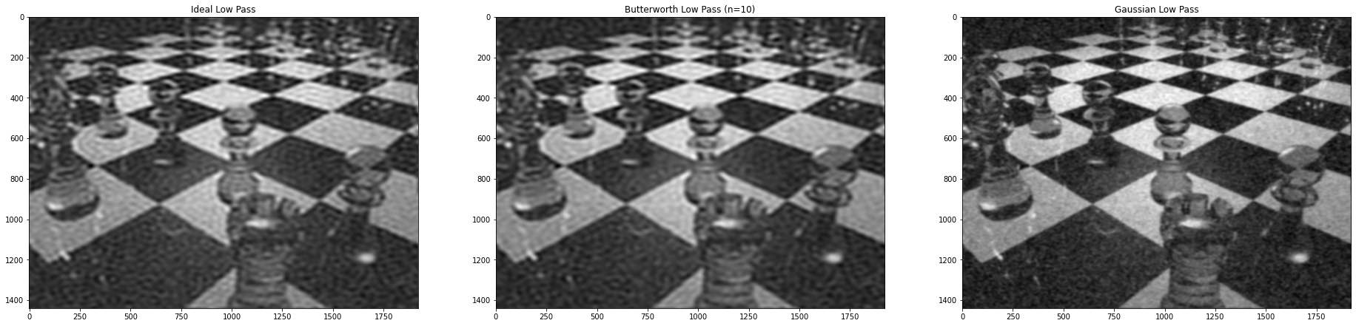
Comparison between filters:
Resulting images after inverse fft, low pass filters

Slide 16
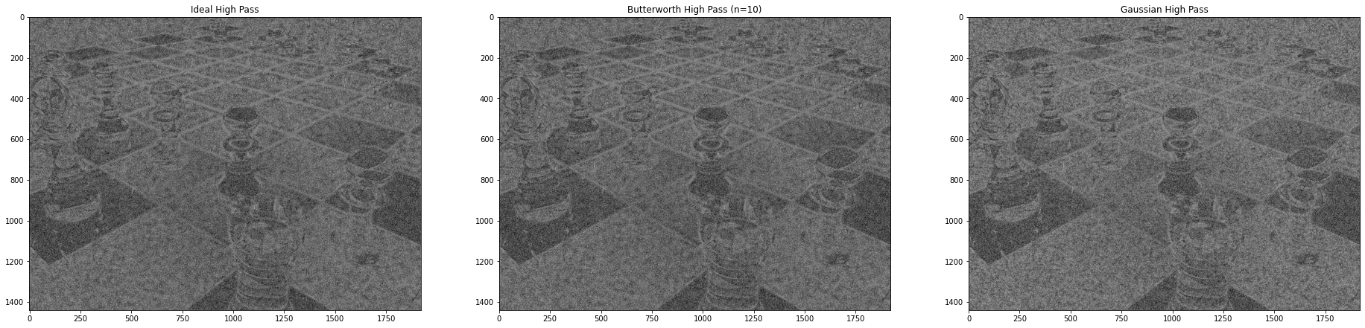
Comparison between filters:
Resulting images after inverse fft, high pass filters

Slide 17
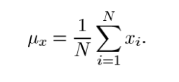
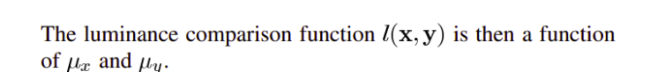
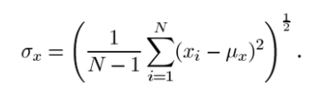
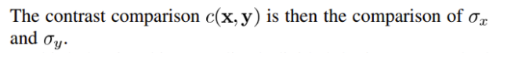
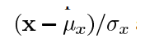
Similarity Metrics: SSIM (structural similarity index)
Luminance:
Contrast:
Similarity:

Slide 18
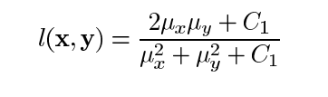
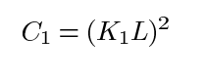
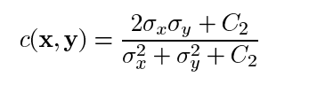
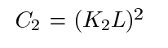
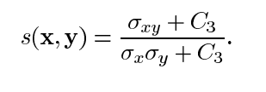
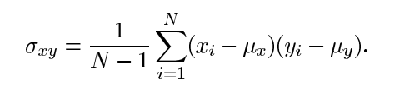
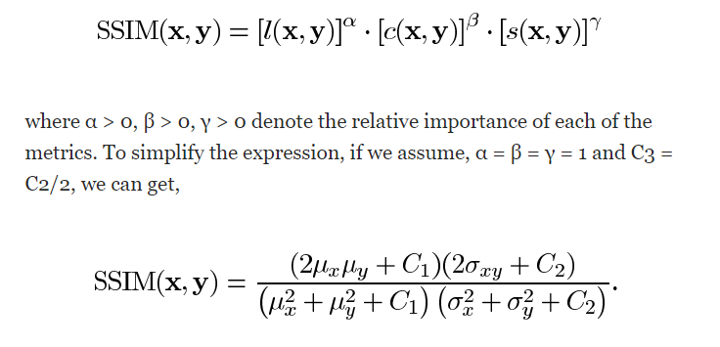
Similarity Metrics: SSIM (structural similarity index)
Luminescence Comparison Function:
-1≤SSIM≤1
Contrast Comparison Function:
Structure Comparison Function:

Slide 19
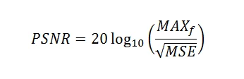
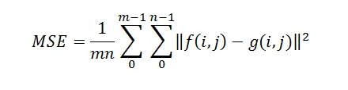
PSNR: Peak signal to noise ratio

Slide 20
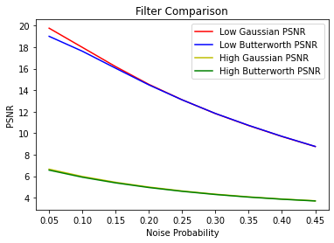
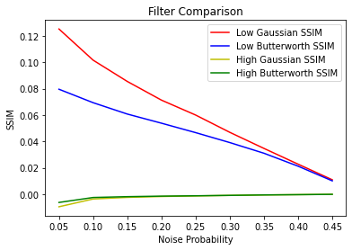
Results: SSIM and PSNR wrt varying levels of noise:

Slide 21
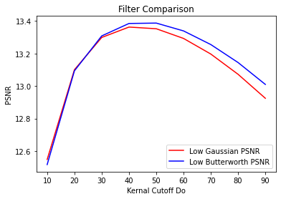
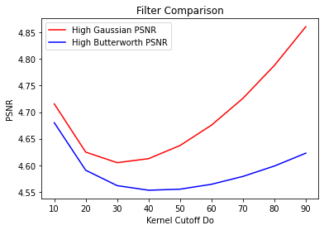
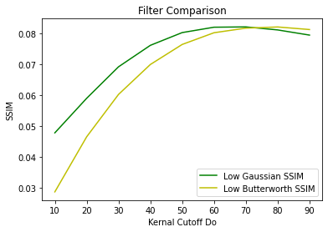
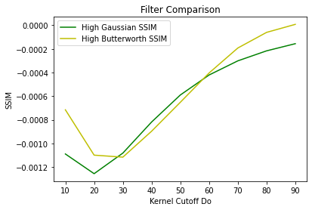
Results SSIM and PSNR with varying D₀:

Slide 22
Thank You

